Slide 1
Python - Pandas
Dr Ronak Panchal

Slide 2
What is Pandas?
Pandas is a Python library used for working with data sets.
It has functions for analyzing, cleaning, exploring, and manipulating data.
The name "Pandas" has a reference to both "Panel Data", and "Python Data Analysis" and was created by Wes McKinney in 2008.

Slide 3
Why Use Pandas?
Pandas allows us to analyze big data and make conclusions based on statistical theories.
Pandas can clean messy data sets, and make them readable and relevant.
Relevant data is very important in data science.

Slide 4
What Can Pandas Do?
Pandas gives you answers about the data. Like:
Is there a correlation between two or more columns?
What is average value?
Max value?
Min value?
Pandas are also able to delete rows that are not relevant, or contains wrong values, like empty or NULL values. This is called cleaning the data.

Slide 5
Installation of Pandas
If you have Python and PIP already installed on a system, then installation of Pandas is very easy.
Install it using this command:
C:\Users\Your Name>pip install pandas
Import Pandas
Once Pandas is installed, import it in your applications by adding the import keyword:
import pandasandas

Slide 6
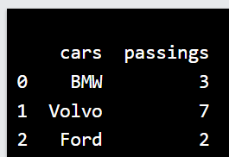
import pandas mydataset = { 'cars': ["BMW", "Volvo", "Ford"], 'passings': [3, 7, 2] } myvar = pandas.DataFrame(mydataset) print(myvar)

Slide 7
Now the Pandas package can be referred to as pd instead of pandas.
import pandas as pd mydataset = { 'cars': ["BMW", "Volvo", "Ford"], 'passings': [3, 7, 2] } myvar = pd.DataFrame(mydataset) print(myvar)

Slide 8
What is a Series?
A Pandas Series is like a column in a table.
It is a one-dimensional array holding data of any type.
Create a simple Pandas Series from a list:
import pandas as pd a = [1, 7, 2] myvar = pd.Series(a) print(myvar)

Slide 9
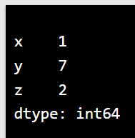
Labels
If nothing else is specified, the values are labeled with their index number. First value has index 0, second value has index 1 etc.
This label can be used to access a specified value.
import pandas as pd a = [1, 7, 2] myvar = pd.Series(a, index = ["x", "y", "z"]) print(myvar)

Slide 10
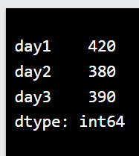
Create a simple Pandas Series from a dictionary:
import pandas as pd calories = {"day1": 420, "day2": 380, "day3": 390} myvar = pd.Series(calories) print(myvar)

Slide 11
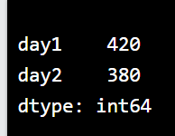
To select only some of the items in the dictionary, use the index argument and specify only the items you want to include in the Series.
import pandas as pd
calories = {"day1": 420, "day2": 380, "day3": 390}
myvar = pd.Series(calories, index = ["day1", "day2"])
print(myvar)

Slide 12
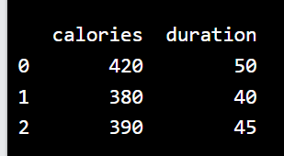
DataFrames
Data sets in Pandas are usually multi-dimensional tables, called DataFrames.
Series is like a column, a DataFrame is the whole table.
import pandas as pd data = { "calories": [420, 380, 390], "duration": [50, 40, 45] } myvar = pd.DataFrame(data) print(myvar)

Slide 13
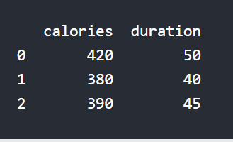
What is a DataFrame?
A Pandas DataFrame is a 2 dimensional data structure, like a 2 dimensional array, or a table with rows and columns.
Create a simple Pandas DataFrame:
import pandas as pd data = { "calories": [420, 380, 390], "duration": [50, 40, 45] } #load data into a DataFrame object: df = pd.DataFrame(data) print(df)

Slide 14

Locate Row
As you can see from the result above, the DataFrame is like a table with rows and columns.
Pandas use the loc attribute to return one or more specified row(s)
#refer to the row index: print(df.loc[0])

Slide 15
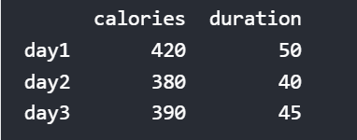
Named Indexes
With the index argument, you can name your own indexes.
Add a list of names to give each row a name:
import pandas as pd data = { "calories": [420, 380, 390], "duration": [50, 40, 45] } df = pd.DataFrame(data, index = ["day1", "day2", "day3"]) print(df)

Slide 16
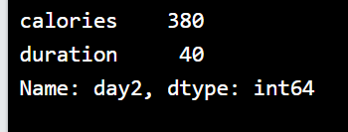
Locate Named Indexes
Use the named index in the loc attribute to return the specified row(s).
import pandas as pd
data = {
"calories": [420, 380, 390],
"duration": [50, 40, 45]
}
df = pd.DataFrame(data, index = ["day1", "day2", "day3"])
print(df.loc["day2"])

Slide 17
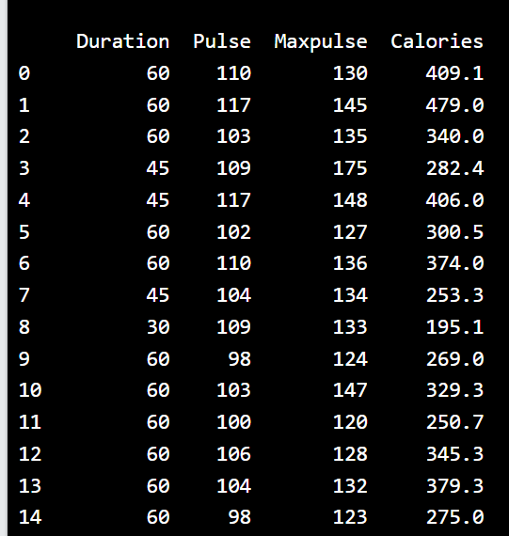
Load Files Into a DataFrame
If your data sets are stored in a file, Pandas can load them into a DataFrame.
Load a comma separated file (CSV file) into a DataFrame:
import pandas as pd df = pd.read_csv('data.csv') print(df)

Slide 18
Read CSV Files
use to_string() to print the entire DataFrame.
A simple way to store big data sets is to use CSV files (comma separated files).
CSV files contains plain text and is a well know format that can be read by everyone including Pandas.
In our examples we will be using a CSV file called 'data.csv’. https://www.w3schools.com/python/pandas/data.csv
import pandas as pd df = pd.read_csv('data.csv') print(df.to_string())
use to_string() to print the entire DataFrame.

Slide 19
Check the number of maximum returned rows:
import pandas as pd print(pd.options.display.max_rows)
The number of rows returned is defined in Pandas option settings.
You can check your system's maximum rows with the pd.options.display.max_rows statement.
In my system the number is 60, which means that if the DataFrame contains more than 60 rows, the print(df) statement will return only the headers and the first and last 5 rows.

Slide 20
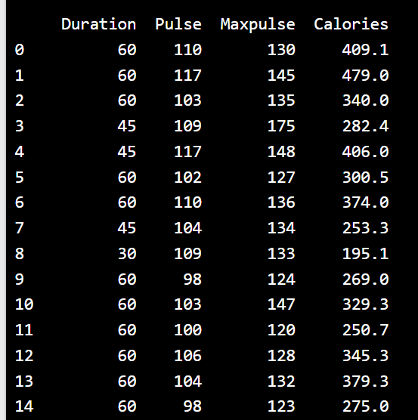
Read JSON
Big data sets are often stored, or extracted as JSON.
JSON is plain text, but has the format of an object, and is well known in the world of programming, including Pandas.
In our examples we will be using a JSON file called 'data.json'.
https://www.w3schools.com/python/pandas/data.js
Load the JSON file into a DataFrame:
import pandas as pd df = pd.read_json('data.json') print(df.to_string())

Slide 21
Dictionary as JSON
JSON objects have the same format as Python dictionaries.
If your JSON code is not in a file, but in a Python Dictionary, you can load it into a DataFrame directly:
Load a Python Dictionary into a DataFrame:
import pandas as pd data = { "Duration":{ "0":60, "1":60, "2":60, "3":45, "4":45, "5":60 }, "Pulse":{ "0":110, "1":117, "2":103, "3":109, "4":117, "5":102 }, "Maxpulse":{ "0":130, "1":145, "2":135, "3":175, "4":148, "5":127 }, "Calories":{ "0":409, "1":479, "2":340, "3":282, "4":406, "5":300 } } df = pd.DataFrame(data) print(df)

Slide 22
Pandas - Analyzing DataFrames
Viewing the Data
One of the most used method for getting a quick overview of the DataFrame, is the head() method.
The head() method returns the headers and a specified number of rows, starting from the top.
Get a quick overview by printing the first 10 rows of the DataFrame:
import pandas as pd
df = pd.read_csv('data.csv')
print(df.head(10))

Slide 23
There is also a tail() method for viewing the last rows of the DataFrame.
The tail() method returns the headers and a specified number of rows, starting from the bottom.
Example
Print the last 5 rows of the DataFrame:
print(df.tail())

Slide 24
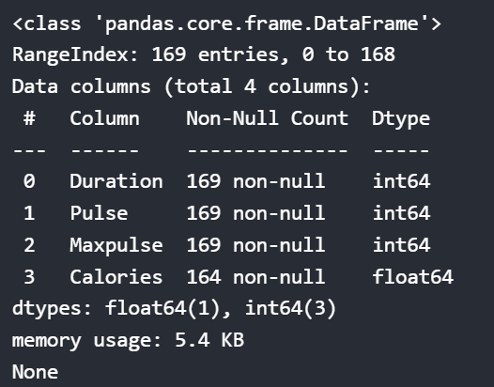
Info About the Data
The DataFrames object has a method called info(), that gives you more information about the data set.
Print information about the data:
print(df.info())
The info() method also tells us how many Non-Null values there are present in each column, and in our data set it seems like there are 164 of 169 Non-Null values in the "Calories" column.
Which means that there are 5 rows with no value at all, in the "Calories" column, for whatever reason.
Empty values, or Null values, can be bad when analyzing data, and you should consider removing rows with empty values. This is a step towards what is called cleaning data, and you will learn more about that in the next chapters.

Slide 25
Data Cleaning
Data cleaning means fixing bad data in your data set.
Bad data could be:
Empty cells
Data in wrong format
Wrong data
Duplicates

Slide 26
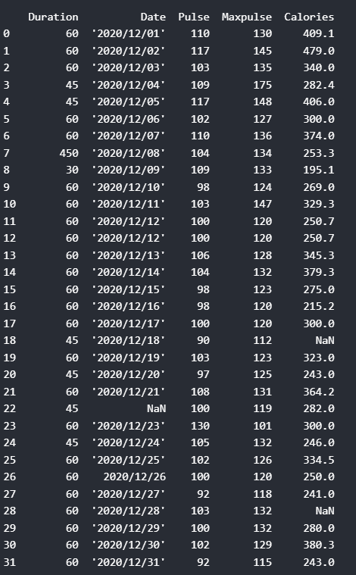
The data set contains some empty cells ("Date" in row 22, and "Calories" in row 18 and 28).
The data set contains wrong format ("Date" in row 26).
The data set contains wrong data ("Duration" in row 7).
The data set contains duplicates (row 11 and 12).

Slide 27
Remove Rows
One way to deal with empty cells is to remove rows that contain empty cells.
This is usually OK, since data sets can be very big, and removing a few rows will not have a big impact on the result.
Example
Return a new Data Frame with no empty cells:
import pandas as pd df = pd.read_csv('data.csv') new_df = df.dropna() print(new_df.to_string())

Slide 28
If you want to change the original DataFrame, use the inplace = True argument:
Remove all rows with NULL values:
import pandas as pd
df = pd.read_csv('data.csv')
df.dropna(inplace = True)
print(df.to_string())
Now, the dropna(inplace = True) will NOT return a new DataFrame, but it will remove all rows containg NULL values from the original DataFrame.

Slide 29
Replace Empty Values
Another way of dealing with empty cells is to insert a new value instead.
This way you do not have to delete entire rows just because of some empty cells.
The fillna() method allows us to replace empty cells with a value:
Replace NULL values with the number 130:
import pandas as pd
df = pd.read_csv('data.csv')
df.fillna(130, inplace = True)

Slide 30
Replace Only For Specified Columns
The example above replaces all empty cells in the whole Data Frame.
To only replace empty values for one column, specify the column name for the DataFrame:
Example
Replace NULL values in the "Calories" columns with the number 130:
import pandas as pd df = pd.read_csv('data.csv') df["Calories"].fillna(130, inplace = True)

Slide 31
Replace Using Mean, Median, or Mode
A common way to replace empty cells, is to calculate the mean, median or mode value of the column.
Pandas uses the mean() median() and mode() methods to calculate the respective values for a specified column:
Calculate the MEAN, and replace any empty values with it:
import pandas as pd
df = pd.read_csv('data.csv')
x = df["Calories"].mean()
df["Calories"].fillna(x, inplace = True)
Mean = the average value (the sum of all values divided by number of values).

Slide 32
Calculate the MEDIAN, and replace any empty values with it:
import pandas as pd df = pd.read_csv('data.csv') x = df["Calories"].median() df["Calories"].fillna(x, inplace = True)
Median = the value in the middle, after you have sorted all values ascending.

Slide 33
Calculate the MODE, and replace any empty values with it:
import pandas as pd df = pd.read_csv('data.csv') x = df["Calories"].mode()[0] df["Calories"].fillna(x, inplace = True)
Mode = the value that appears most frequently.

Slide 34
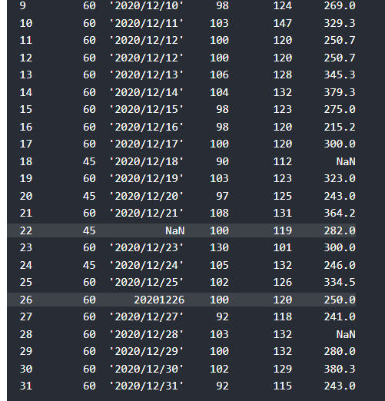
Pandas - Cleaning Data of Wrong Format
Data of Wrong Format
Cells with data of wrong format can make it difficult, or even impossible, to analyze data.
To fix it, you have two options: remove the rows, or convert all cells in the columns into the same format.
Convert Into a Correct Format
In our Data Frame, we have two cells with the wrong format. Check out row 22 and 26, the 'Date' column should be a string that represents a date:

Slide 35
Let's try to convert all cells in the 'Date' column into dates.
Pandas has a to_datetime() method for this:
Convert to date:
import pandas as pd
df = pd.read_csv('data.csv')
df['Date'] = pd.to_datetime(df['Date'])
print(df.to_string())

Slide 36
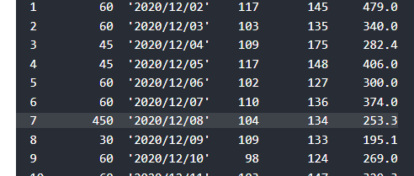
Pandas - Fixing Wrong Data
Wrong Data
"Wrong data" does not have to be "empty cells" or "wrong format", it can just be wrong, like if someone registered "199" instead of "1.99".
Sometimes you can spot wrong data by looking at the data set, because you have an expectation of what it should be.
If you take a look at our data set, you can see that in row 7, the duration is 450, but for all the other rows the duration is between 30 and 60.
It doesn't have to be wrong, but taking in consideration that this is the data set of someone's workout sessions, we conclude with the fact that this person did not work out in 450 minutes.
Set "Duration" = 45 in row 7:
df.loc[7, 'Duration'] = 45

Slide 37
For small data sets you might be able to replace the wrong data one by one, but not for big data sets.
To replace wrong data for larger data sets you can create some rules, e.g. set some boundaries for legal values, and replace any values that are outside of the boundaries.
Example
import pandas as pd
df = pd.read_csv('data.csv')
for x in df.index:
if df.loc[x, "Duration"] >120:
df.loc[x, "Duration"] = 120
print(df.to_string())

Slide 38
Removing Rows
import pandas as pd
df = pd.read_csv('data.csv')
for x in df.index:
if df.loc[x, "Duration"] > 120:
df.drop(x, inplace = True)
#remember to include the 'inplace = True' argument to make the changes in the original DataFrame object instead of returning a copy
print(df.to_string())
Another way of handling wrong data is to remove the rows that contains wrong data.
This way you do not have to find out what to replace them with, and there is a good chance you do not need them to do your analyses.
Example
Delete rows where "Duration" is higher than 120:
for x in df.index:
if df.loc[x, "Duration"] > 120:
df.drop(x, inplace = True)

Slide 39
Pandas - Removing Duplicates
import pandas as pd
df = pd.read_csv('data.csv')
print(df.duplicated())
To discover duplicates, we can use the duplicated() method.
The duplicated() method returns a Boolean values for each row:
Returns True for every row that is a duplicate, othwerwise False.

Slide 40
Pandas - Data Correlations
Finding Relationships
A great aspect of the Pandas module is the corr() method.
The corr() method calculates the relationship between each column in your data set.
The examples in this page uses a CSV file called: 'data.csv'. https://www.w3schools.com/python/pandas/data.csv
import pandas as pd
df = pd.read_csv('data.csv')
print(df.corr())

Slide 41
Result Explained
The Result of the corr() method is a table with a lot of numbers that represents how well the relationship is between two columns.
The number varies from -1 to 1.
1 means that there is a 1 to 1 relationship (a perfect correlation), and for this data set, each time a value went up in the first column, the other one went up as well.
0.9 is also a good relationship, and if you increase one value, the other will probably increase as well.
-0.9 would be just as good relationship as 0.9, but if you increase one value, the other will probably go down.
0.2 means NOT a good relationship, meaning that if one value goes up does not mean that the other will.
What is a good correlation? It depends on the use, but I think it is safe to say you have to have at least 0.6 (or -0.6) to call it a good correlation.
Perfect Correlation:
We can see that "Duration" and "Duration" got the number 1.000000, which makes sense, each column always has a perfect relationship with itself.
Good Correlation:
"Duration" and "Calories" got a 0.922721 correlation, which is a very good correlation, and we can predict that the longer you work out, the more calories you burn, and the other way around: if you burned a lot of calories, you probably had a long work out.
Bad Correlation:
"Duration" and "Maxpulse" got a 0.009403 correlation, which is a very bad correlation, meaning that we can not predict the max pulse by just looking at the duration of the work out, and vice versa.

Slide 42
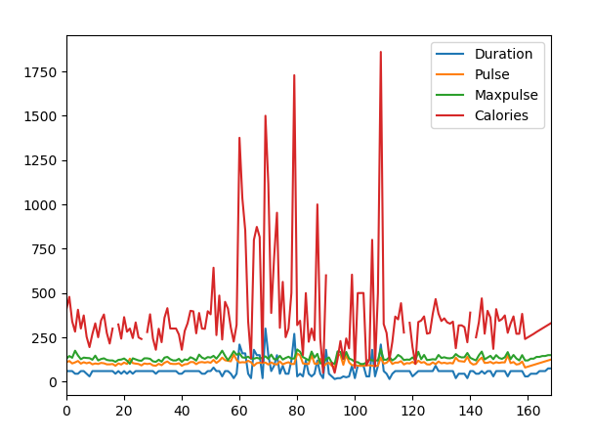
Pandas uses the plot() method to create diagrams.
We can use Pyplot, a submodule of the Matplotlib library to visualize the diagram on the screen.
Import pyplot from Matplotlib and visualize our DataFrame:
import pandas as pd
import matplotlib.pyplot as plt
df = pd.read_csv('data.csv')
df.plot()
plt.show(df)

Slide 43
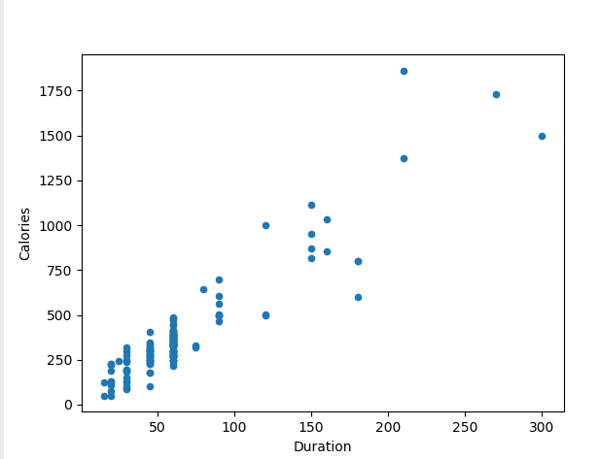
import pandas as pd import matplotlib.pyplot as plt df = pd.read_csv('data.csv') df.plot(kind = 'scatter', x = 'Duration', y = 'Calories') plt.show()

